Slide 1

ARES EmComm and
Traffic Handling
Plain Language, Radiograms, & ICS-213 FOrms
Hank Grilk – WA2CCN
EPA DEC for ARES Distric-3
Wayne County EC

Slide 2
Contents:
Communications Formats
  Plain Language
    Personal Log Book
  Radiograms
  FEMA ICS-213
How to Communicate a Radiogram ON-THE-AIR
  Phonetics
  Pro-Words
  HX and ARL Codes
General “SCRIPT” for Sending a Radiogram

Slide 3

Communications Formats…
Plain Language
  On-Site intercom
  Site Stations to/from Site HQ
  No forms! Log all info in Personal ARES LOGBOOK
  Use TACTICAL CALL SIGNS
Radiograms
  Default message form
  EMERGENCY, PRIORITY, WELFARE, ROUTINE, & SERVICE messages
ICS-213
  Used primarily for EmComm with Government Agencies
  Used whenever required by a Served Agency
  May use Radiograms for WELFARE & ROUTINE

Slide 4

Example Situation:
Incident Site in Deep Valley
SITE-1
SP-1
…on nearby
mountain top
SITE-2
Incident Command HQ
Relay Station
County EOC
SITE-3
FA-1
FD-1

Slide 5
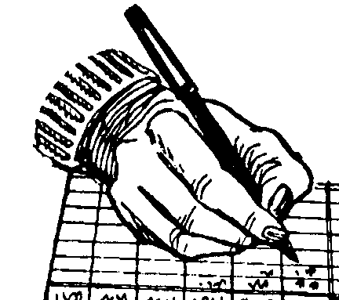
Personal ARES Logbook… On Site... When hanging with assigned person or functional group…
No time to fill out any “forms”
No convenient desk or location to fill out “forms”
No storage location for “forms”
No detailed info on addressee available
Gotta act quickly… but accurately!

Slide 6
Scribble best you can and re-write later

Slide 7
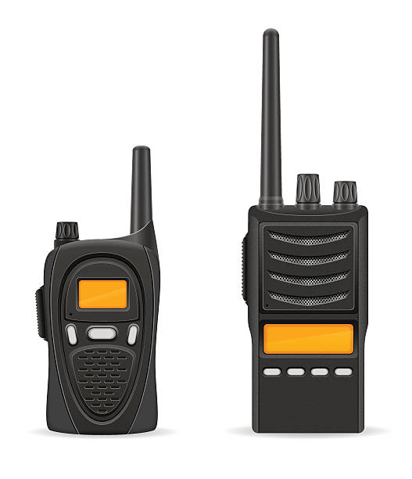
Site Station to/from Incident Command HQ Station
Site Station sends message info to IC HQ Station in PLAIN LANGUAGE
IC HQ Station records message info (Date / Time / Who / What / etc. in his Personal ARES Log Book
IC HQ Station takes info and originates a Radiogram (or ICS-213 form)
IC HQ Station communicates message DRAFT back to Site Station for approval
Site Station checks with message originator and gets approval (or corrections)
Site Station notifies IC HQ Station of OK (or any editing)
IC HQ Station sends message

Slide 8

Now, let’s take a look at the FORMS…
Radiogram
  Standard ARRL NTS (National Traffic System) form
  Been around since the 1920’s – continually optimized
  Includes important preamble info
  Simple and effective
ICS-213
  Used by the Government – FEMA, State/County, Fire Dept., etc.
  Based on old inter-office memo pad
  Lacks important preamble info
Other
  Any other form specified by a Served Agency

Slide 9
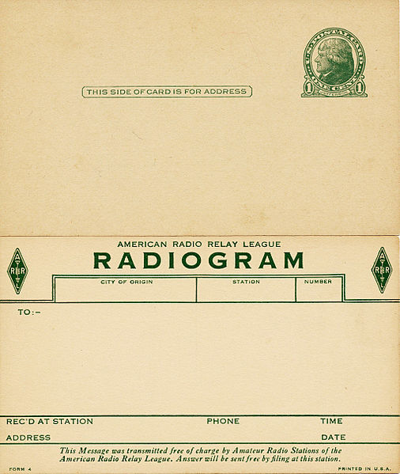
Antique
Radiogram

Slide 10
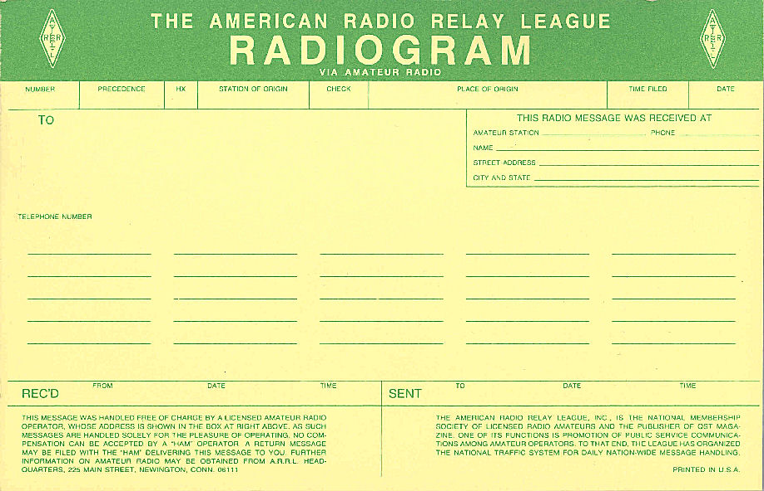

Slide 11
Radiogram sections…
PREAMBLE
  Information to track the message
ADDRESS:
  Name and address of the intended recipient
  (…followed by optional delivery “Op Note”)
Text
  The actual message information
Signature
  The party for whom the message was originated
  (…followed by optional service or reply “Op Note”)

Slide 12
Radiogram Preamble - - - NUMBER
This is the Serial Number of the message
It is assigned by the Station of Origin and never changed.
Numbering is necessary because hams may handle dozens of messages daily, and without a numbering system it would be difficult to identify any given message.
K.I.S.S. - The number should be sequential numbers (1, 2, 3, etc.).
If a Service Note message, precede the number with “SVC”.
You can put a “T” or “D” for “Training” or “Drill” before the number.
NOTE: Radiogram software programs don’t like letters in the number box!

Slide 13
Radiogram Preamble - - - PRECEDENCE (Importance)
“Precedence” is the IMPORTANCE of the message
“EMERGENCY” (If Precedence is EMERGENCY, SPELL IT OUT!)
“P” = Priority (Important “time value” messages)
“W” = Welfare (Health & Welfare messages)
“R” = Routine (Normal stuff, low priority)
“TEST” = Test message used for training and drills

Slide 14

EMERGENCY (Spelled out on the form, and sent phonetically.)
  Any message having life and death urgency to any person or group of persons, which is transmitted by Amateur Radio in the absence of regular commercial facilities.
  This includes official messages of welfare agencies during emergencies requesting supplies, materials or instructions vital to relief of stricken populace in emergency areas.
  During normal times, it will be very rare.
  Again, this designation will always be spelled out.
  When in doubt, do not use it.

Slide 15

Radiogram Preamble - - - Handling Instructions (HX)
“HX” Codes are used to indicate special handling instructions.
If there are no special handling instructions, leave this box blank.
For HX codes, say “Hotel X-Ray Bravo” for “HXB”
Commonly used HX codes…
    HXB (Cancel message if not delivered within ____ hours and generate SVC message)
    HXC (Report date/time of delivery via SVC message)
    HXE (Delivering station get a reply from addressee and generate SVC message)
    HXF (Hold delivery until date)

Slide 16
Radiogram Preamble - - - Station of ORIGIN
The call sign of the amateur station originating (creating) the message for first introduction into the amateur system is the station of origin and must be on all messages.
The only punctuation symbol permitted is a slash after the call followed by a number… eg, “WA2CCN/3”
This call sign must stay with the message to the point of delivery.
Service messages go to this station.

Slide 17
Radiogram Preamble - - - “CHECK” Number
The check is the number of “word groups" in the text of the message and must be used on all messages.
This number is used by operators to verify that the text has been copied with the correct number of groups.
There are two ways to enter the check in the preamble:
    The check is entered as the number of word groups in the text if there are NO ARRL NUMBERED “ARL Codes” in the text.
    The check is preceded by the letters "ARL" if the text includes one or more ARRL NUMBERED ARL Codes.

Slide 18
“ARL” Codes…
Codes used to shorten message length
Two Groups of Codes
  Group One – For possible “Relief Emergency” use
  Group Two - - For routine messages
When using an ARL code in the text, precede the Check Number with the letters “ARL”… eg, “ARL 12”
Example: ARL Code “FIFTY TWO” = “Really enjoyed being with you. Looking forward to getting together again.” (Saves 11 words!)
When using an ARL code in the text, you MUST spell out the code number phonetically.

Slide 19
Radiogram Preamble - - - Place of ORIGIN
The PLACE OF ORIGIN is the location (city and state) of the party for whom the message is created, not necessarily the location of the station of origin.
For example, if the station of origin is in Baltimore creating a message for a person in Ellicott City, the PLACE OF ORIGIN would be Ellicott City.
The PLACE OF ORIGIN relates to the signature and should make sense to the addressee as the place the signing party is located.
The state is given by the US standard two letter code as in "BALTIMORE MD", or "CHICAGO IL". No punctuation!

Slide 20
Radiogram Preamble - - - Time Filed
The OPTIONAL "TIME FILED" is used only when filing time has some importance relative to the precedence, handling instructions, or meaning in the text.
TIME FILED is the time when the message is inserted into the system by the station of origin.
The time figures are in the 24-hour format followed by the letter "Z" to denote UTC time, or “L” to denote local time, as in "0215Z" or "2215L".
The TIME FILED is normally omitted on routine traffic having no special time concerns.

Slide 21
Radiogram Preamble - - - Date Filed
As with the time filed, the DATE FILED is the day when the message is inserted into the system by the station of origin.
The date filed can be in either the DAY/MO or MO/DAY format. For example, “23 JAN” or “JAN 23”.
The YEAR is normally omitted from the DATE FILED box as the date (with year) that the message is communicated is logged at the bottom of the Radiogram form as RCVD FROM or SENT TO. Here “slash” (“/”) marks can be used as in “1/23/21”.

Slide 22
Radiogram ADDRESS Section:
The ADDRESS Section should include the recipient’s name, Amateur Call (if applicable), address (Street/City/State/Zip) and Contact Info (phone number, e-mail address, etc.).
No punctuations in the name. For example, no period after a middle initial, no comma before or period after “JR” (Junior).
No period after abbreviations for Street (ST), Avenue (AVE), etc.
No comma between City & State.
Zip Code is given as either “FIGURES” or “NUMBER GROUP” even though zip codes are 5+ digits long.
Phone Numbers are given as one set of figures as in “FIGURES FIFE SEVEN ZERO THREE NINER ZERO ONE TWO THREE FOUR”
E-Mail addresses are given as a MIXED GROUP as in “WHISKY ALPHA TWO CHARLIE CHARLIE NOVEMBER AT SIGN ALPHA ROMEO ROMEO LIMA DOT NET”.

Slide 23
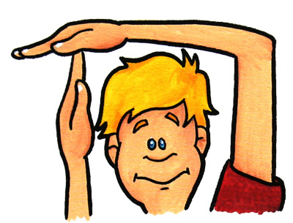
>>> A quickie about the word BREAK !!! <<<
The term “BREAK” is only used for two functions during traffic handling and communicating Radiograms
First time “Break” is used is AFTER sending all Preamble and Address info… say “BREAK FOR TEXT” and stop transmitting.
Wait for the receiving station to say “GO”. This indicates that…
  …all message info received OK, or…
  …all questions answers (fills, corrections, clarifications, etc.) and now OK
The second time “BREAK” is used is AFTER sending the TEXT. Say “BREAK FOR SIGNATURE” - - - don’t stop transmitting and immediately go to the signature.

Slide 24
Radiogram TEXT Section
The TEXT section is divided into 25 spaces for WORDS… 5 per line, 5 lines.
At the bottom is a space for the “SIGNATURE” of the message originator.
A “WORD” is any actual word, or…
  Initials or group of initials…
  ……….Number or group of numbers…
  ………………..A mixed group of initials, numbers, etc. …or…
  …………………………A spelled-out punctuation mark

Slide 25
Radiogram SIGNATURE Section
Signature area
Usual Signature – Name(s) & Call Letters of Ham(s) originating the message, or,
Name(s) of Non-Ham (eg, “Joe Biden” or “Mom & Dad”, etc.)
After the name (& Call) the signature may include…
  Sender’s Title
  “Op Notes” about the sender, any reply instructions, etc.
If originating the Radiogram, leave “REC’D” blank. Otherwise record Call Letters, Date, Opt. Time, when message received for relay or delivery
When sending the Radiogram, record Call Letters, Date, Opt. Time to whom the Radiogram is sent.

Slide 26
NOTE: GWM sent CK 25 – corrected to 24

Slide 27
That’s it for Radiograms.
Now, on to the
ICS-213 Form

Slide 29

FEMA ICS-213 Form Info…
As you can see, the form is a “no-brainer”… just fill in the blanks.
Make use of plain language (no “codes”) wherever possible.
Write the text as if you were writing a letter, with punctuation marks.
When sending an ICS-213 message, spell out punctuation when you see one. (eg, you see “;”, send “SEMICOLON”).
Use all other standard PRO-WORDS used for Radiograms.
Actual signatures aren’t necessary. Just spell-out.

Slide 30

Now, the PROBLEMS with the ICS-213…
On the ICS-213 Form there are no spots for…
  Message Number
  Message Precedence or Priority
  Identification of the Ham Radio Operator sending the message
  Location of the Ham Radio Operator sending the message
  No “CHECK” number – no way to check the accuracy of the sent message
  No place for address or contact info for the sender
All this stuff is part of the PREAMBLE of a Radiogram
Again, the ICS-213 was based on an “interoffice memo pad” form.
On the PLUS side (for emergency communications) there’s plenty of space for text… no 25-word limit.

Slide 31

ARRL’s Position on the ICS-213…
Re Modifying the ICS-213 Form…. DON’T DO IT !!!!!!!
The ARRL included a whole section in their ARES Manual devoted to why we are not to modify the ICS-213… see Section “5.5 Modification of ICS Forms Including ICS-213” of the Manual!
Many people have tried to come up with alternative forms and calling them ICS-213AR (Amateur Radio) or some other near-’213 designation. This is a NO-NO!
So, how can we hams deal with the lack of important information?
We can KILL it !!!!!!!!

Slide 32

KILL !!!
Key Information Legend Line

Slide 33
7A – KILL: Number / Precedence or Priority / Handling Instructions “HX” / Check # / Place of Origin
7B – TEXT: (Enter actual message text here)
7C – ROUTING:
1 – FROM, TO, TIME, DATE
2 – FROM, TO, TIME, DATE
3 – FROM, TO, TIME, Date
4 – etc.

Slide 34
RT 191 CRASH
STEVE PRICE DIRECTOR WAYNE CO EMA AT WAYNE CO EMA, 570-253-1622
PETE HOOKER DEPUTY DIRECTOR WAYNE CO EMA – INCIDENT COMMANDER
WALL TENTS
13 OCT
1018L
7A – KILL: 14 / PRIORITY / CK 14 / EQUINUNK PA
7B – TEXT: DRILL NEED 3 STANDARD WALL TENTS ASAP X PLEASE ADVISE ETA X 73 DRILL
7C – ROUTING:
1 – HOOKER TO K0PB 1021L 10/13/20
2 – KOPB TO KZ3MW 1024L 10/13/20
3 – KZ3MW TO PRICE 1029L 10/13/20
4 – etc.
P HOOKER
INC CMNDR

Slide 35
9A KILL: 14 / PRIORITY / CK 10 / EOC
9B TEXT: DRILL SCHEDULED ETA FOR TENTS IS 1120L X 73 DRILL
9C ROUTING:
1 – PRICE TO KZ3MW 1034L 10/13/20
2 – KZ3MW TO K0PB 1037L 10/13/20
3 – K0PB TO HOOKER 1041L 10/13/20
S PRICE
DIR EMA
1034L 10/13/20

Slide 36
How to COMMUNICATE a Radiogram
…or other message format on-the-air.

Slide 37
ARRL National Traffic System (NTS) Levels…
LOCAL (Kindergarten)
  Basic training level
  Club or County nets
  ARES nets
SECTION (Grammar School)
  ARRL Sections like EPA (Eastern PA Emergency Phone and Traffic Net (EPAEPTN)
REGION (High School)
  3rd Region Net (3RN) - DE, MDC, EPA, WPA
AREA (Collage)
  Eastern, Central, & Pacific
TCC (Post-Grad, PhD)
  Transcontinental Corp

Slide 38

PHONETICS !!!!!!
You MUST use proper phonetics!
WWII phonetics were intentionally skewed to confuse the enemy
  WASHINGTON AMERICA TWO CANADA CANADA NORWAY
  WILMA ARLENE TWO CAROL CAROL NANCY
  WILLY AFRICA TWO CHARLIE CHAN’S NEPHEW
  WIESBADEN ALTENBERG ZWEI COLOGNE COLOGNE NURNBERG
Standard phonetics established by ITU primarily for air traffic control
Also properly pronounce phonetics and numbers!

Slide 39


Alpha
Bravo
Charlie
Delta
Echo
Foxtrot
Golf
Hotel
India
Juliet
Kilo
Lima
Mike
November
Oscar
Papa
Quebec
Romeo
Sierra
Tango
Uniform
Victor
Whisky
X-Ray
Zulu
1 – Wahn
2 – Too
3 – Tha-ree
4 – Fo-are
5 – Fife
6 – Six
7 – Se-van
8 – Ate
9 – Niner
0 – Zee-row

Slide 40
Pro-words…
“Pro-words” are words or phrases PRECEEDING the word “group” to help understand the group on-the-air.
There are some “rules” for the use of pro-words that are easy to memorize… but…
…improper use of pro-words is one of the most common errors when sending/relaying traffic (messages).
Here’s some pro-words and their “rules”

Slide 41


Pro-words… Numbers and the “Rule of 3’s”
For a word group consisting of 1 – 3 numbers, use the pro-word “FIGURE(S)”
  5 = “FIGURE FIFE”
  59 = “FIGURES FIFE NINER”
  509 = “FIGURES FIFE ZERO NINER”
For a word group consisting of 4 or more numbers, use the pro-word “NUMBER GROUP”
  1234 = “NUMBER GROUP ONE TWO THREE FOUR”
  98765 = “NUMBER GROUP NINER EIGHT SEVEN SIX FIFE”
For a word group with both numbers and letters, use the pro-word “MIXED GROUP”
  4TH = “MIXED GROUP FOUR TANGO HOTEL”
  3918KHZ = “MIXED GROUP THREE NINER ONE EIGHT KILO HOTEL ZULU”

Slide 42
Pro-words… Letters and the “Rule of 3’s”
For a word group consisting of 1 – 3 letters, use the pro-word “INITIAL(S)”
  A = “INITIAL ALPHA”
  ST = “INITIALS SIERRA TANGO”
  MRS = “INITIALS MIKE ROMEO SIERRA:
For a word group consisting of 4 or more letters, use the pro-word “LETTER GROUP”
  ARRL = “LETTER GROUP ALPHA ROMEO ROMEO LIMA”
  ARISS = “LETTER GROUP ALPHA ROMEO INDIA SIERRA SIERRA”
Again, for a word group with both numbers and letters, use the pro-word “MIXED GROUP”
  4TH = “MIXED GROUP FOUR TANGO HOTEL”
  3918KHZ = “MIXED GROUP THREE NINER ONE EIGHT KILO HOTEL ZULU”

Slide 43

Other Pro-Words and Rules…
There are 3 ways to use a “.”
  Period at the end of a sentence – say “X-RAY”
  Decimal Point in a number group – use “R” (Romeo) as “3.918MHz" would be “MIXED GROUP THREE ROMEO NINER ONE EIGHT MIKE HOTEL ZULU”
  For a dot in an e-mail address, simply say “DOT”, as in HANK@GRILK.NET would be “HOTEL ALPHA NOVEMBER KILO AT SIGN GRILK DOT NET”
For phone numbers…
  In the ADDRESS section, say “PHONE FIGURES FIFE SEVEN ZERO THREE NINER ZERO FOUR ONE TWO FIFE”
  In the TEXT section, break the number into 3 words… “FIGURES FIFE SEVEN ZERO FIGURES THREE NINER ZERO NUMBER GROUP FOUR ONE TWO FIFE”

Slide 44
The infamous “I SPELL”….
When sending a Radiogram (or any on-the-air message) it is important to consider band conditions, quality of the received signal, complexity of the word being sent (how unusual is the word?), spelling, etc. to determine when to spell out a word.
When you feel it’s prudent to spell out a word, say the word, then say “I SPELL” and proceed to spell the word phonetically.
After you finish spelling out the word phonetically, leave a reasonable “pause” before proceeding with the next word.
Example: “…WAYNE I SPELL WHISKY ALPHA YANKEE NOVEMBER ECHO COUNTY…”

Slide 45
Hint - - -
Put a little I for “Initial” or F for “Figure” before words to remind you what pro-word to use.

Slide 46

Punctuations, etc.
SPELL OUT PUNCTUATIONS…
  . = X-RAY (Period) or R (“Romeo” for a decimal point)
  , = “COMMA”
  ; = “SEMICOLON
  ; = COLON
  - = DASH (except in a MIXED WORD)
  / = SLASH (except in a MIXED WORD)
  ? = QUERY
  ! = EXPLANATION POINT (2 words)
  “ = QUOTE (1 word) and CLOSE QUOTE (2 words)

Slide 47
Sending a Radiogram… PREAMBLE
Start the PREAMBLE with the message NUMBER –
  OK to say “PLEASE COPY NUMBER xxx”, but at higher level traffic nets everyone knows that the Radiogram will begin with a number… so they just say “NUMBER xxx”
Next is the PRECEDENCE –
  Everyone knows the next item is the Precedence, so don’t say “Precedence” – just proceed with “ROUTINE” (R) or “PRIORITY” (P) or “WELFARE” (W). Remember that “EMERGENCY” MUST BE SPELLED OUT PHONETICALLY!
Next is Handling Instructions (HX) –
  Again, everyone knows to expect either an “HX” code or – if no “HX” code – just moving on to the STATION OF ORIGIN.
  When sending a “HX” code, don’t just give the code letter (A, B, C, etc.). You must say “HOTEL X-RAY ALPHA” (HXA) or “HOTEL X-RAY ECHO” (HXE)

Slide 48
Sending a Radiogram… PREAMBLE cont’d
Once again, it’s not necessary to say “STATION OF ORIGIN” – everyone expects it is the next item in the Preamble… this applies to each item… just state the next item (I won’t say this again ☺)
  Say “AMATEUR CALL KILO SIX HOTEL TANGO NOVEMBER” (or whatever the call is).
It’s OK to say “CHECK FIGURES TWO FOUR” or just “FIGURES TWO FOUR”
  NOTE the exception when an “ARL” code is used in the text of the message. In this case say “CHECK MIXED GROUP ALPHA ROMEO LIMA TWO FOUR”.
Give the PLACE OF ORIGIN… just the TOWN NAME and STATE (initials) as in:
  “HAWLEY I SPELL HOTEL ALPHA WHISKY LIMA ECHO YANKEE INITIALS PAPA ALPHA”.
Time and Date: Send the TIME only for EMERGENCY, PRIORITY, or other TIME VALUE messages. Send the DATE… I prefer number/month as in
“FIGURE TWO SIX JANUARY” (26 JAN), but certainly month/number is OK.

Slide 49
Sending a Radiogram… ADDRESS
When sending the addressee’s name and call - - -
Send the first name… it’s OK to say “COMMON SPELLING”, as in “RALPH COMMON SPELLING”, or do it phonetically if an unusual name or spelling or bad conditions.
If a middle initial, say “MIDDLE INITIAL DELTA” (for a “D” middle initial, etc.) NOTE no period after the initial.
The last name is usually spelled phonetically, even if it’s a relatively common name such as “Smith” or “Brown” or “Banasiewicz” ☺
If a ham, follow the name with “AMATEUR CALL WHISKY 3 ALPHA BRAVO CHARLIE”
Start the address with “FIGURE(S)” (<3 numbers) or “NUMBER GROUP” (4+ numbers) then the street name (again usually phonetically or maybe a mixed group as in “MIXED GROUP FIFE TANGO HOTEL STREET” for “5th St”.
Next the CITY (spell phonetically) and STATE (use 2-digit initials, eg, “PAPA ALPHA”)
Follow the STATE with “ZIP FIGURES ONE EIGHT FOUR THREE EIGHT”
Phone #’s say “PHONE FIGURES XXX XXX XXXX (no dashes, just 3 sets of numbers)
E-Mail address phonetically – use “AT SIGN” for the “@” and “DOT” for the “.”

Slide 50
“BREAK”
After finishing sending the PREAMBLE and ADDRESS info, say - - - “BREAK FOR TEXT”, and STOP TRANSMITTING!
This break in transmitting the message is an opportunity for the receiving station to check what he has received so far and ask for any…
  FILLS (items missed when it was sent)
  CORRECTIONS
  CLARIFICATIONS
When the receiving station is satisfied that he has everything correct so far, he’ll say “GO”. At this point you can proceed sending the text.
NOTE: In “high level” traffic nets (EAN, 3RN, etc.), the receiving station may not respond with “GO”. If you hear nothing after a few seconds, go ahead, send text.

Slide 51
Sending a Radiogram… TEXT
For “novice” traffic handlers, it’s OK to say “TEXT FOLLOWS”, and then send the text. Otherwise, just start sending the text after receiving the “GO”.
Try to limit the number of “words” to no more than 25
Make use of “ARL Codes” whenever possible
Use Pro-Words and “I SPELL” as often as necessary to assure good copy.
Use proper phonetics and pronunciation of words, letters, & numbers
Refrain from sending text too fast… HINT: Write the text as you send it! With practice you’ll settle into a “groove” for sending techniques and speed.
After sending the text say “BREAK FOR SIGNATURE” but DO NOT STOP SENDING! Immediately proceed with sending the signature.
After sending the signature, send “END” indicating the end of the message, and send either “NO MORE”, or “ONE MORE”, “TWO MORE, etc. if sending more messages.

Slide 52
ARRL “ARL Codes”…
Here’s some examples of “ARL Codes”:
FIFTY = “Greetings by Amateur Radio”
FIFTY FOUR = “Many thanks for your good wishes”
FIFTY FIVE = “Congratulations on your ____ , a most worthy and deserving achievement”
SIXTY ONE = “Wishing you a very Merry Christmas and a Happy New Year”
SIXTY SEVEN = “Your message number ____ undeliverable because of _____ . Please advise.”
ARL Codes Must always be spelled out. For example: ARL FIFTY FOUR =
  “INITIALS ALPHA ROMEO LIMA FIFTY I SPELL FOXTROT INDIA FOXTROT TANGO YANKEE FOUR I SPELL FOXTROT OSCAR UNIFORM ROMEO”

Slide 53
Example sending a Preamble…
Preamble: # 397 / Routine / WA2CCN (Station of Origin) / ARL 12 (Check #) / Lakeville PA (Place of Origin) / 27 JAN (Date)
NUMBER THREE NINER SEVEN
ROUTINE
WHISKY ALPHA TWO CHARLIE CHARLIE NOVEMBER
CHECK MIXED GROUP ALPHA ROMEO LIMA ONE TWO
LAKEVILLE I SPELL LIMA ALPHA KILO ECHO VICTOR INDIA LIMA LIMA ECHO
INITIALS PAPA ALPHA
FILED FIGURES TWO SEVEN JANUARY

Slide 54
Example sending an ADDRESS…
To: Brian Grilk KD2OAZ 23 Edison St Clifton NJ 07013 Phone 973-473- 0108
TO BRIAN (COMMON SPELLING) GRILK I SPELL GOLF ROMEO INDIA LIMA KILO
AMATEUR CALL KILO DELTA TWO OSCAR ALPHA ZULU
FIGURES TWO THREE EDISON I SPELL ECHO DELTA INDIA SIERRA OSCAR NOVEMBER STREET
CLIFTON I SPELL CHARLIE LIMA INDIA FOXTROT OSCAR NOVEMBER
INITIALS NOVEMBER JULIET ZIP FIGURES ZERO ONE ZERO ONE THREE
PHONE FIGURES NINER SEVEN THREE FOUR SEVEN THREE ZERO ONE ZERO EIGHT
BREAK FOR TEXT (Stop Transmitting)

Slide 55
Example sending the TEXT & SIGNATURE…
ARL FIFTY X PLEASE CALL ME AT 570 390 4215 X 73
TEXT FOLLOWS (Optional)
INITIALS ALPHA ROMEO LIMA FIFTY I SPELL FOXTROT INDIA FOXTROT TANGO YANKEE
INITIAL X-RAY PLEASE CALL ME AT FIGURES FIFE SEVEN ZERO THREE NINER ZERO
FOUR TWO ONE FIFE INITIAL X-RAY FIGURES SEVEN THREE
BREAK FOR SIGNAURE
HANK AMATEUR CALL WHISKY ALPHA TWO CHARLIE CHARLIE NOVEMBER
END NO MORE (Stop Transmitting)

Slide 56
Opportunities to handle traffic…
ORIGINATE
  You send a message to a friend or family member or…
  Someone you know would like to send a message to a friend of family member.
  Actively seek opportunities to send a message for somebody, to somebody
RELAY
  On the air – receive a message and relay it to another ham in the NTS
DELIVER
  Receive a message and deliver it to the intended recipient via…
  Phone call or e-mail
  OK to leave messages on telephone answering machines and call it DELIVERED
  Opportunity to introduce people to the public service value of Ham Radio

Slide 57
Phone Traffic Nets….
LOCAL
  Wayne County ARES Net
  Other Club or ARES Nets with a “NTS Liaison Station”
SECTION
  Eastern PA Emergency Phone Traffic Net (EPAEPTN) – 3918KHz/5PM Daily
REGION
  Region-3 Net (3RN) – 3918KHz/4PM Daily
AREA
  Eastern Area Net (EAN) – 7222KHz/2:30 Daily
TRANS-CONTINENTAL
  EAN to/from CAN, CAN to/from PAN, PAN to/from EAN

Slide 58


